Slide 1
Downloading Files from GitHub
https://github.com/The-Assembly/AR_head
The following must be installed on your machine:
Unity3D
Vuforia
Rhubarb
Code Editor
VNC Viewer
Android SDK (optional)

Slide 2
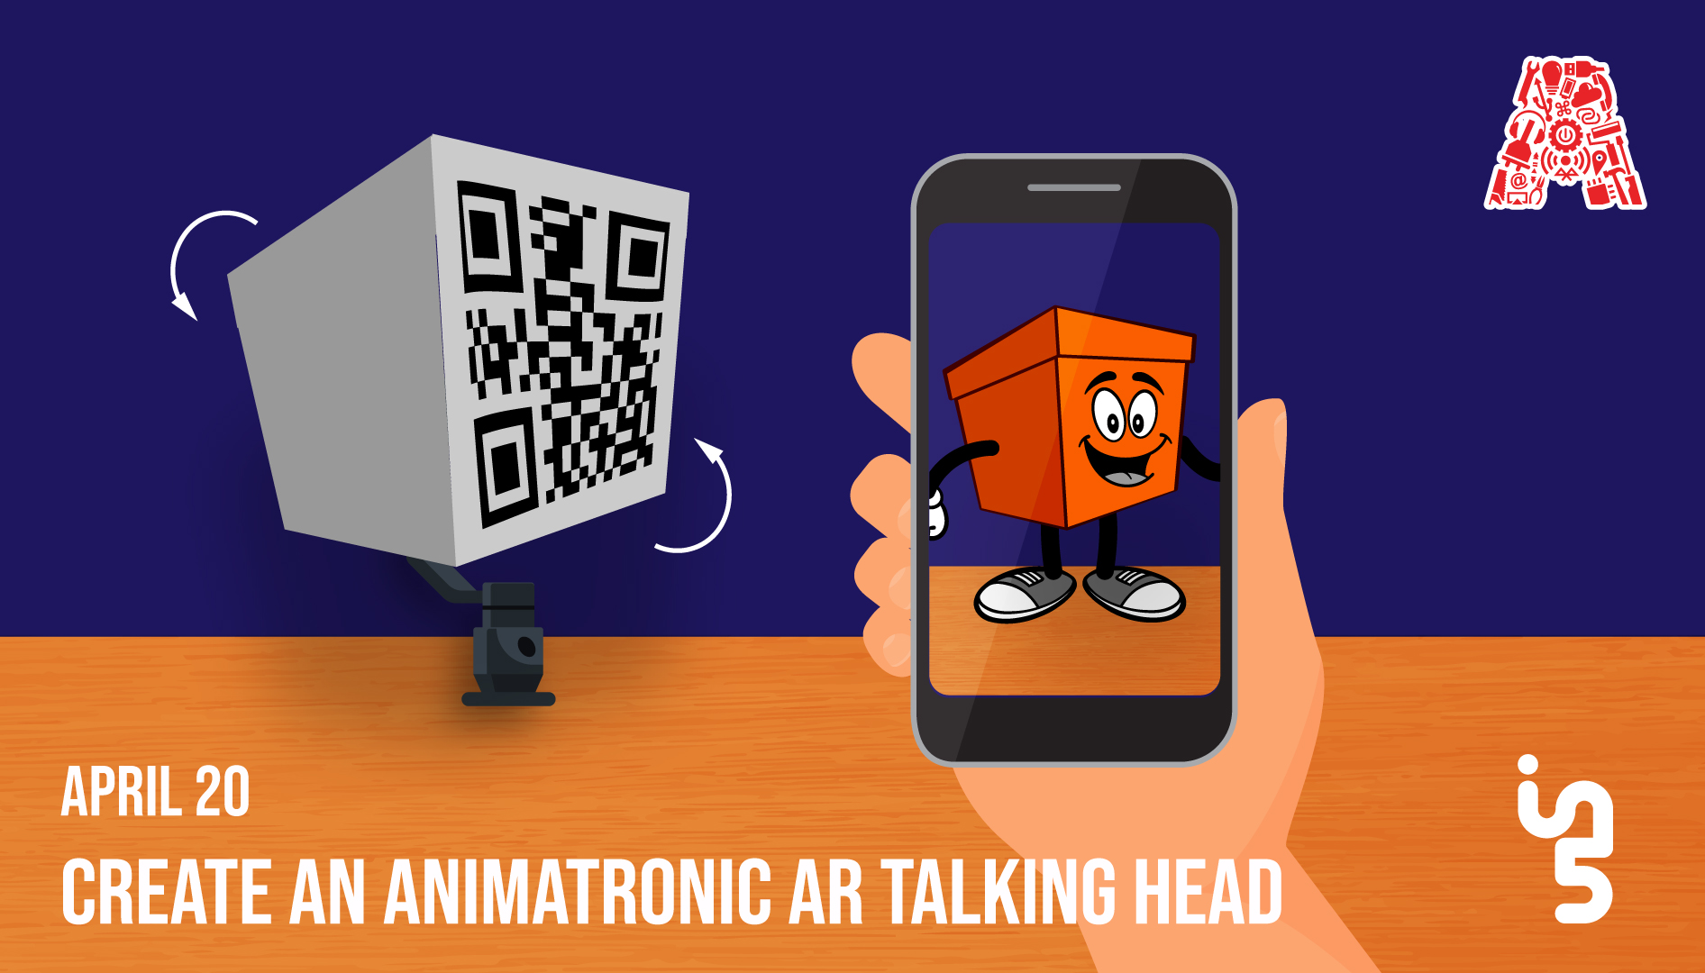

Slide 3
About the Assembly
A smart lab based out of In5 since Dec 2014
Over 200 free workshops done
ASSEMBLY: HACK - Embedded systems, iOT and hardware
ASSEMBLY: CODE - Software projects - APIs, frameworks, apps
Age range: 16-60 - students, professionals, entrepreneurs
Focus on smart technology and practical applications
Forum: members.theassembly.ae

Slide 4
TAG US ON OUR SOCIAL MEDIA
FACEBOOK
TWITTER
INSTAGRAM
YOUTUBE
The Assembly (@MakeSmartThings)
@MakeSmartThings
@MakeSmartThings
The Assembly

Slide 5
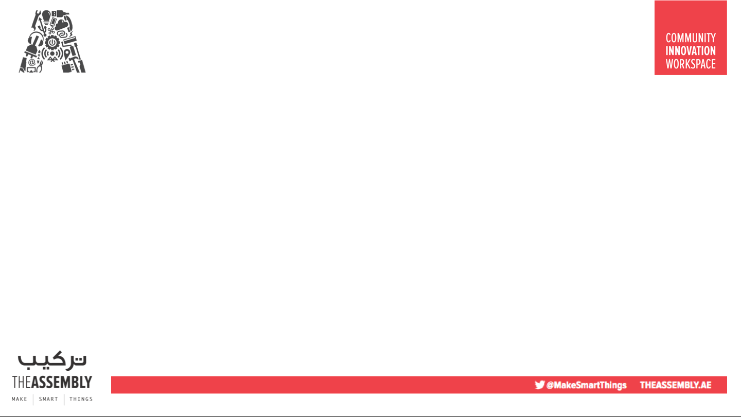

Overview
TOPICS:
Introduction to Unity and Augmented Reality
Setting up hardware components
Preparing the Unity scene (box head)
Adding the movement buttons
Setting up websockets
Final touches
Run code

Slide 6
Dependencies
The following must be installed on your machine:
Unity3D
Vuforia
Rhubarb
Code Editor
VNC Viewer
Android SDK (optional)

Slide 7
Downloading Files from GitHub
https://github.com/The-Assembly/AR_head
The following must be installed on your machine:
Unity3D
Vuforia
Rhubarb
Code Editor
VNC Viewer
Android SDK (optional)

Slide 8
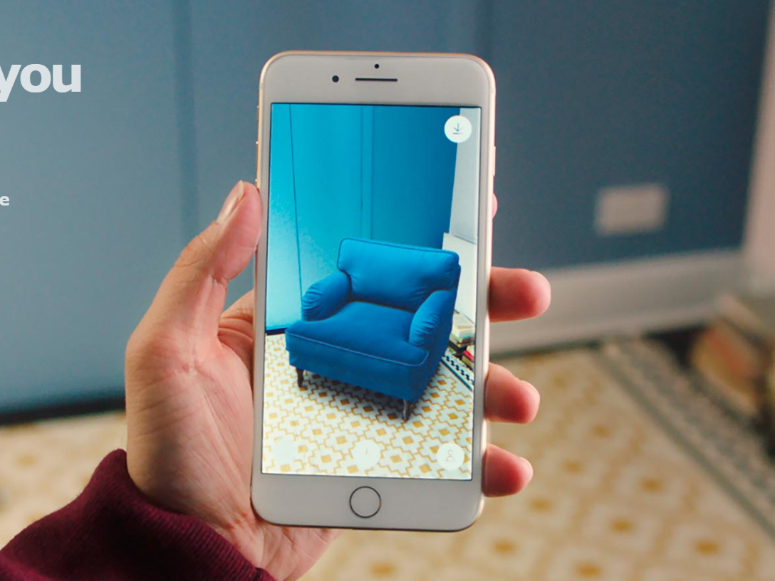
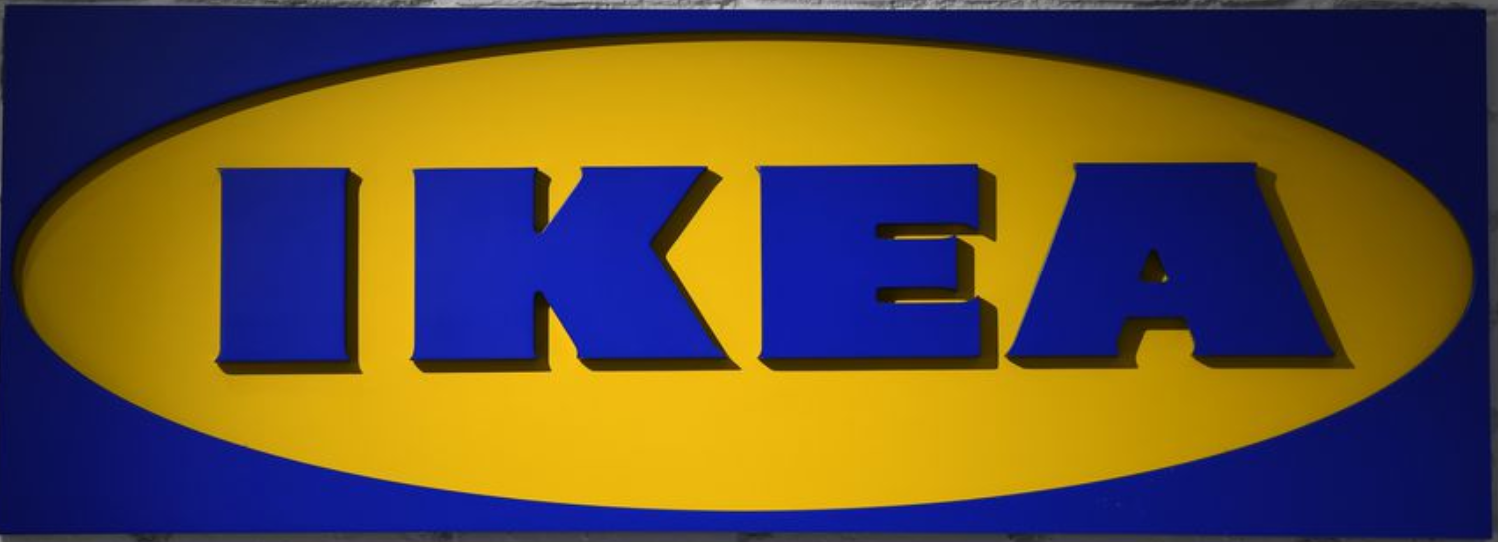
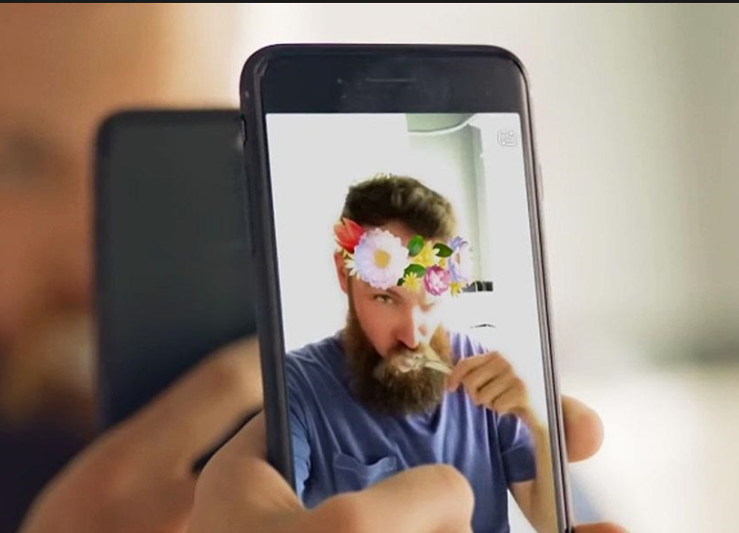

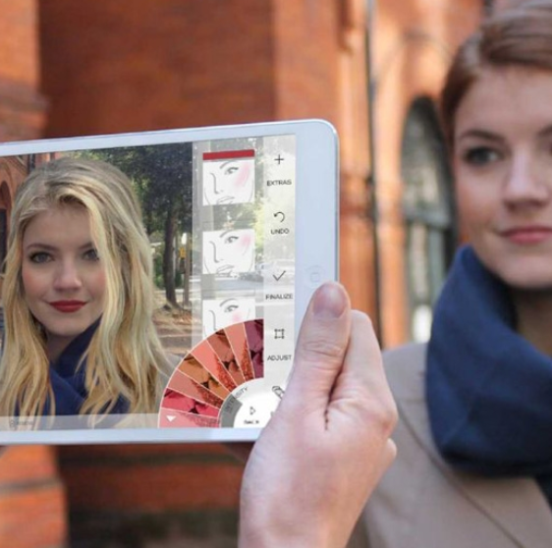

AR
Examples

Slide 9
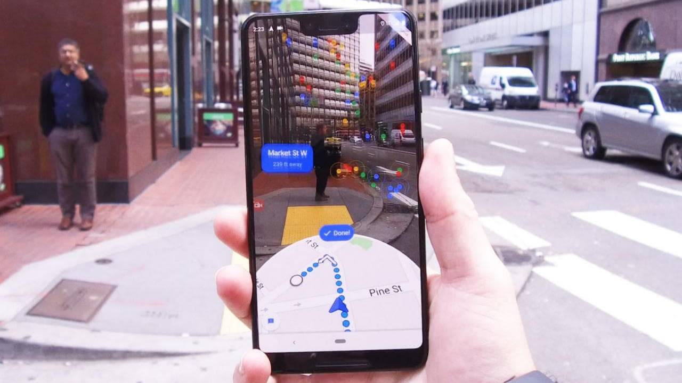

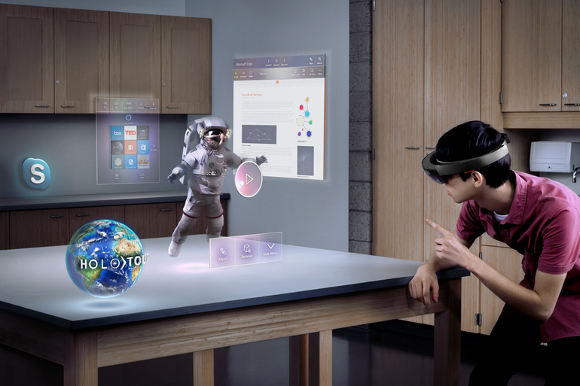

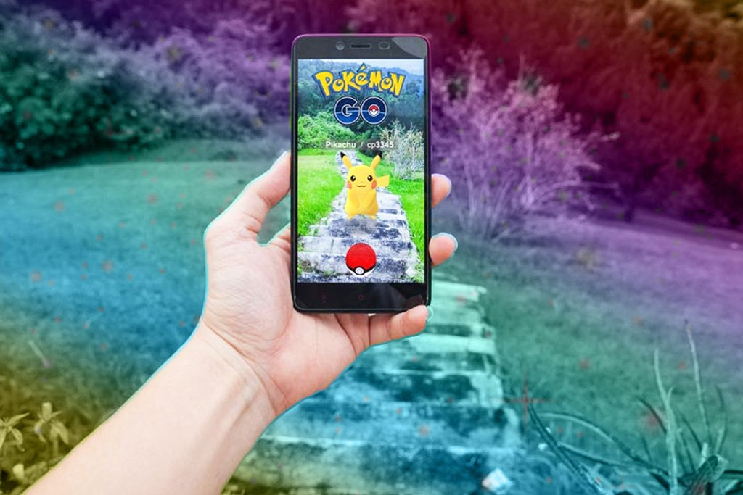


Slide 10

What is Vuforia?
Vuforia is an augmented reality software development kit (SDK) for mobile devices that enables the creation of augmented reality applications.

Slide 11
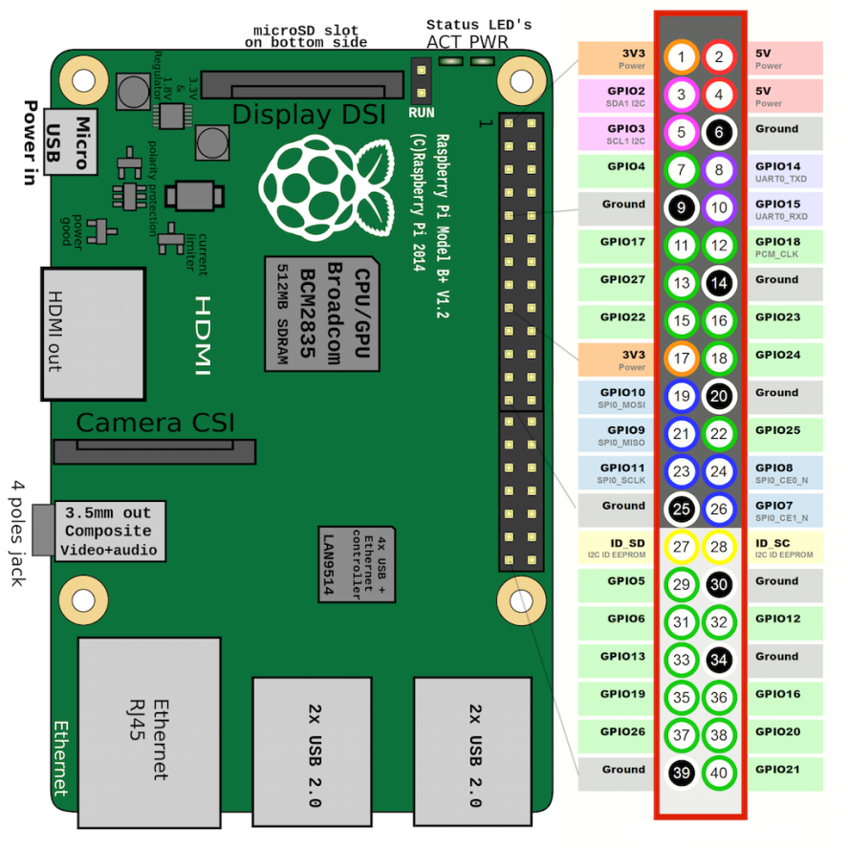
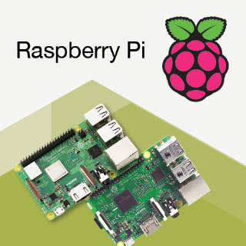
Raspberry Pi

Slide 12
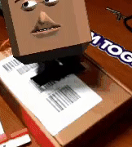
Aim

Slide 13

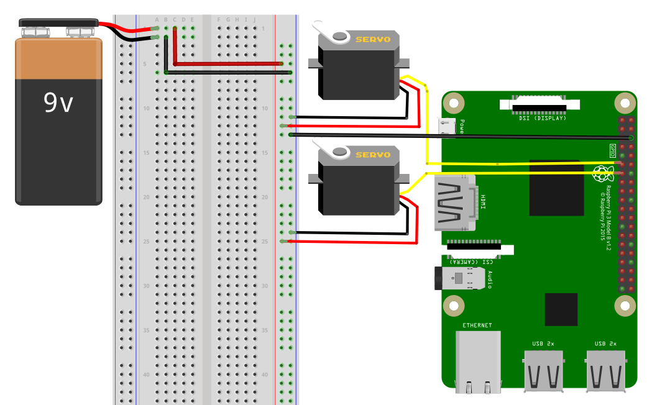
Circuit Overlay
Power
Bank

Slide 14
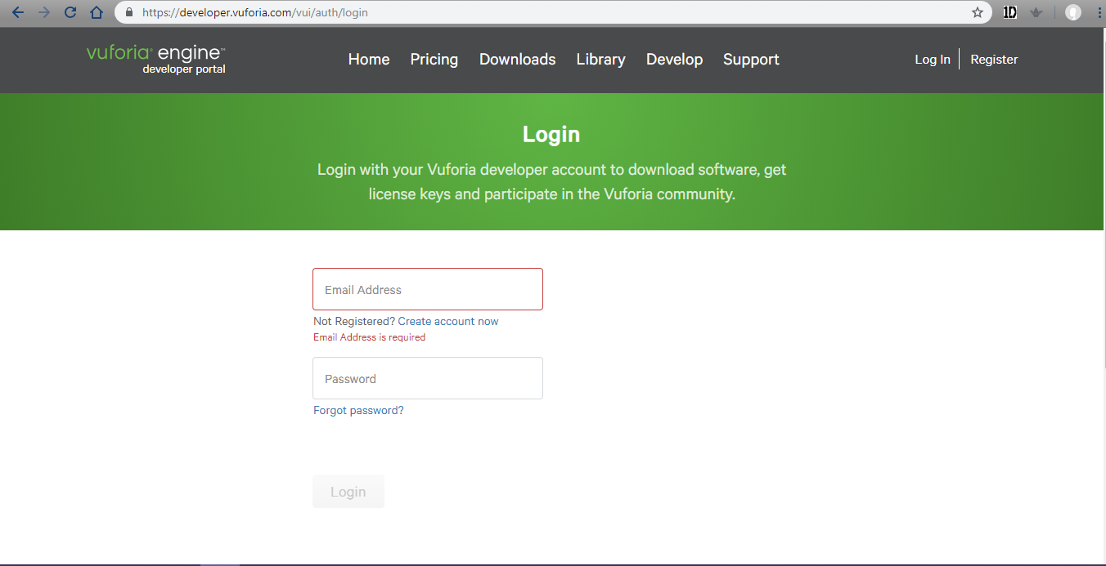

Slide 15
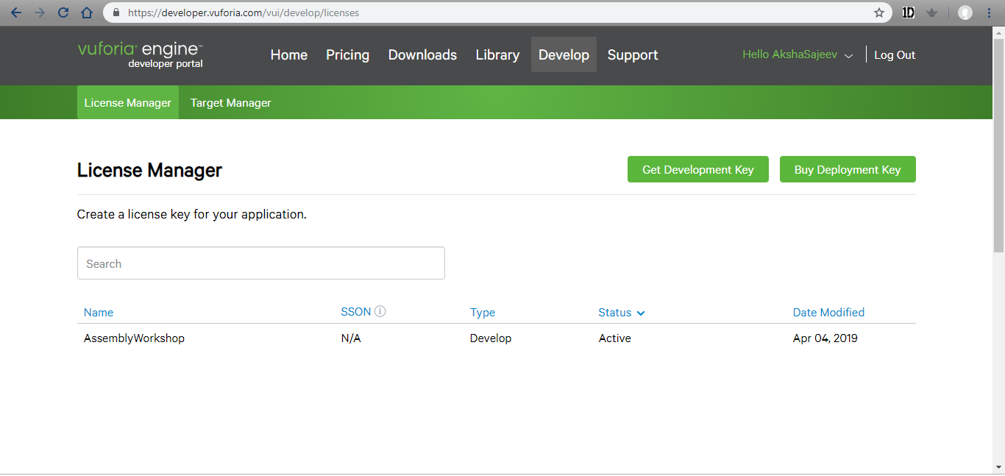

Slide 16
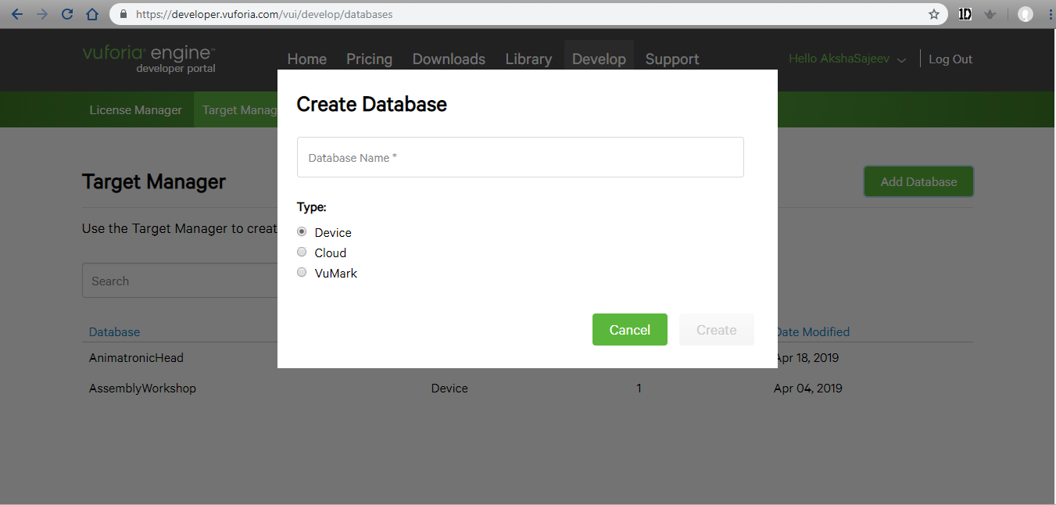

Slide 17
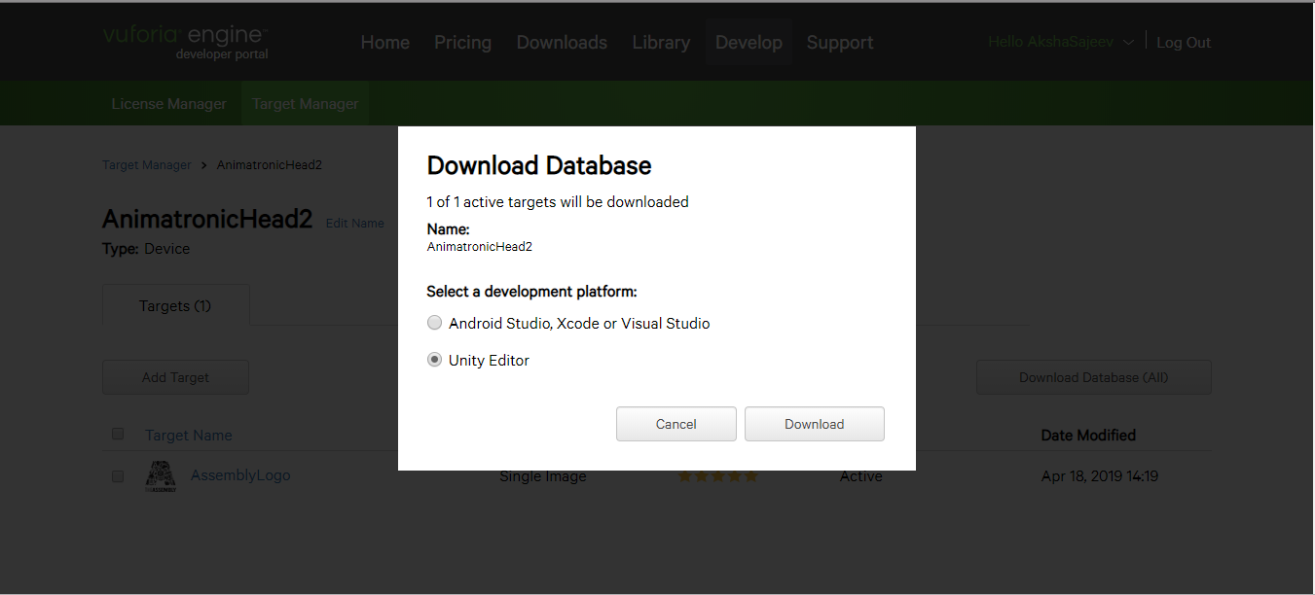

Slide 18
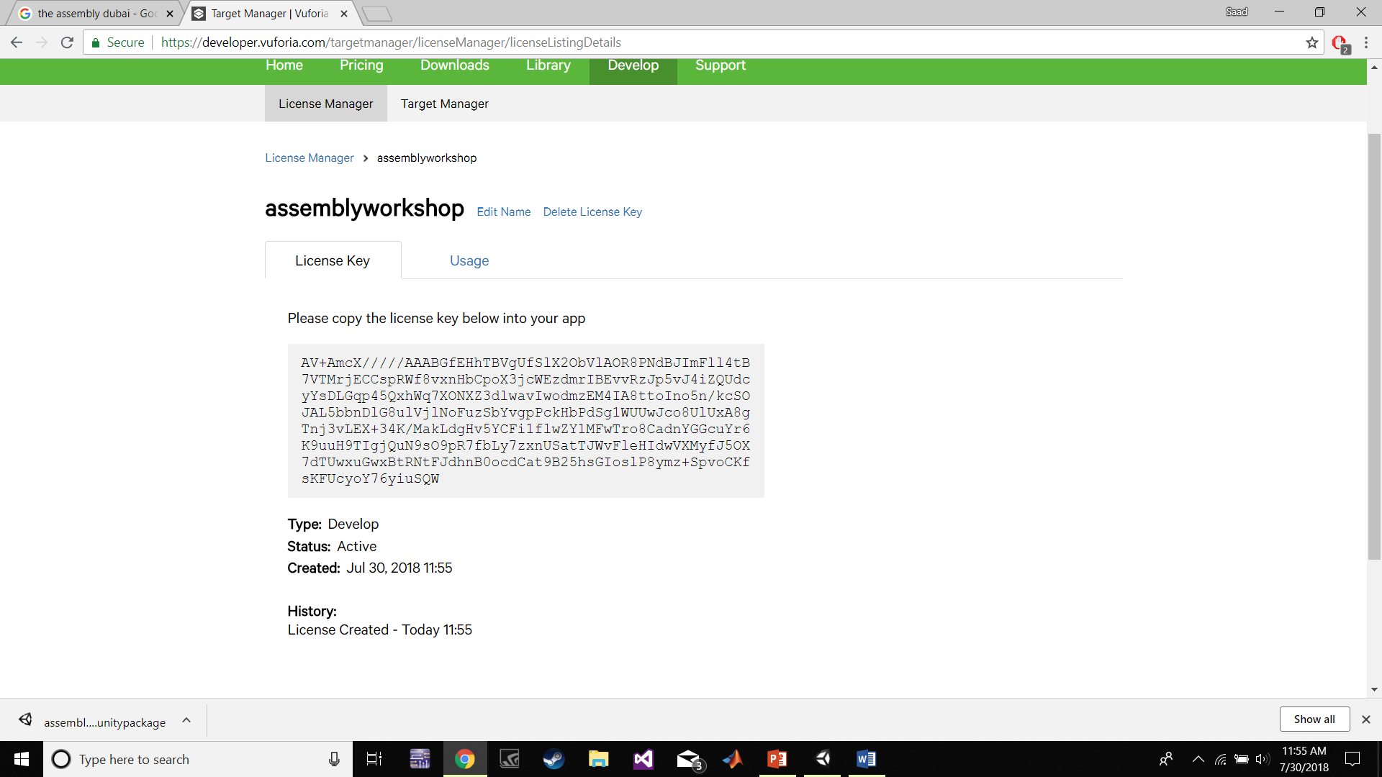

Slide 19
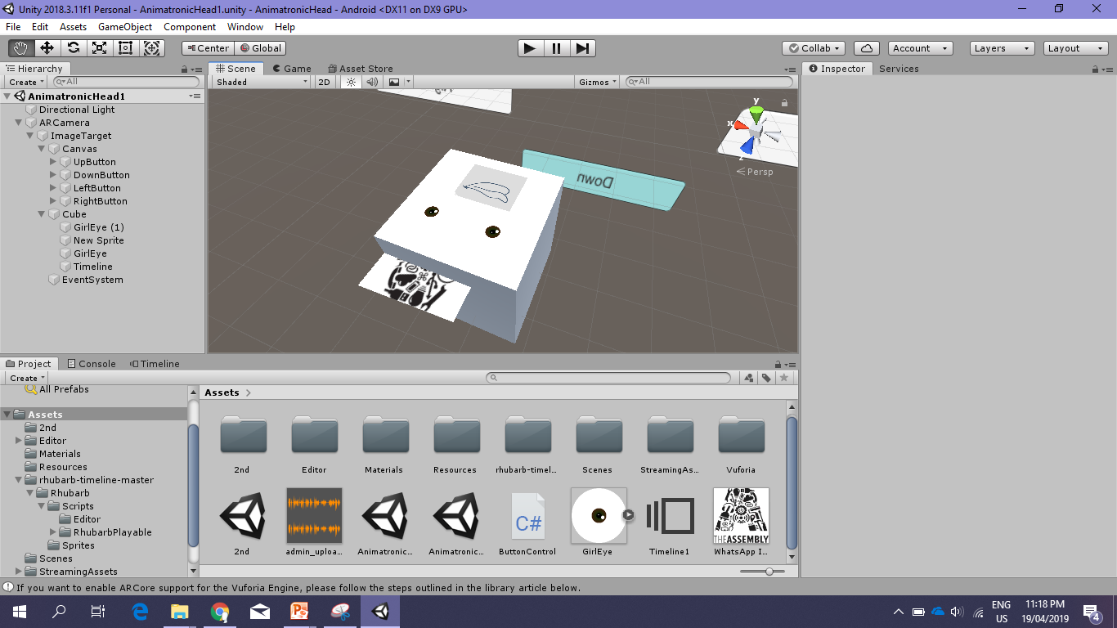

Slide 20
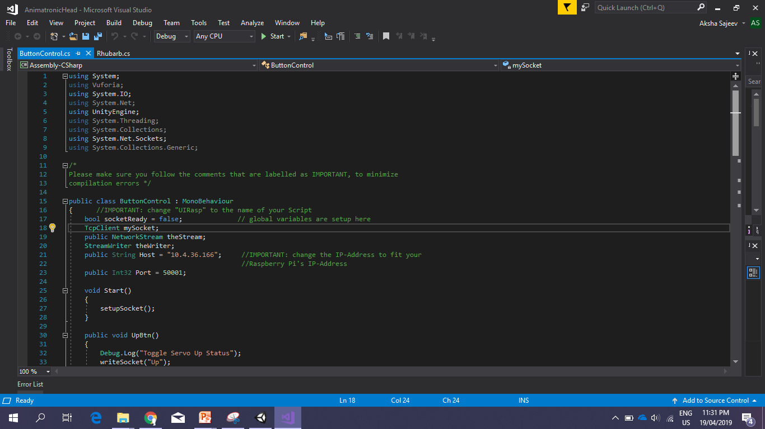

Slide 21
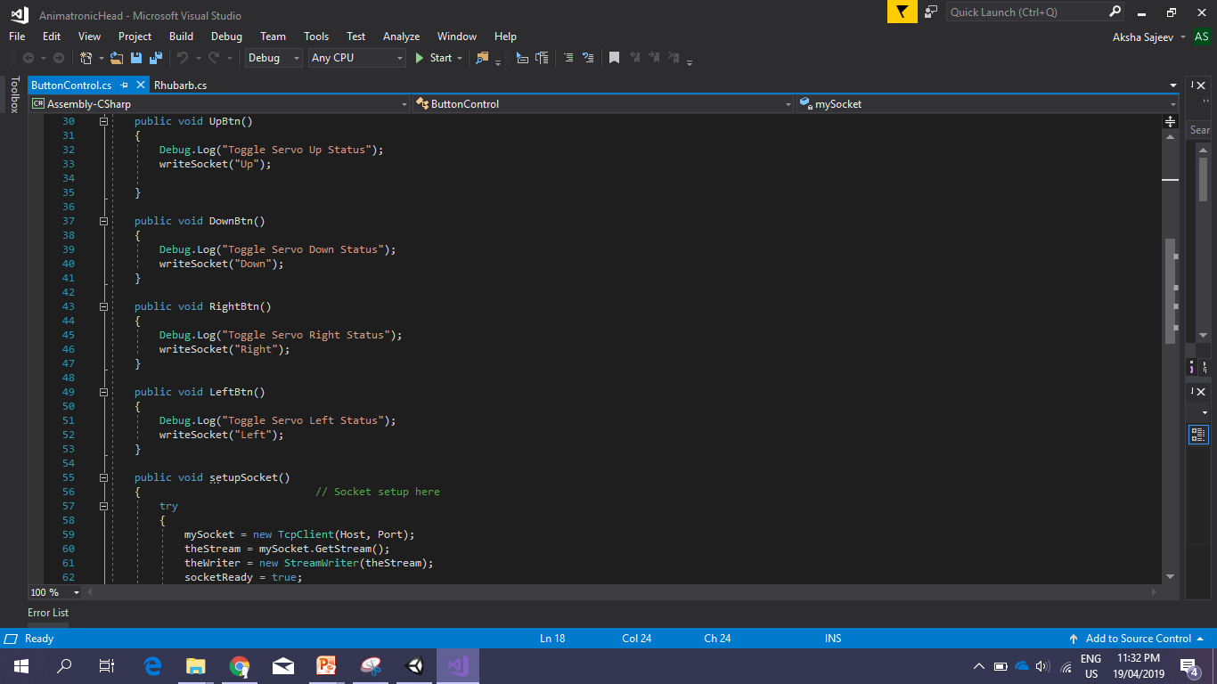

Slide 22
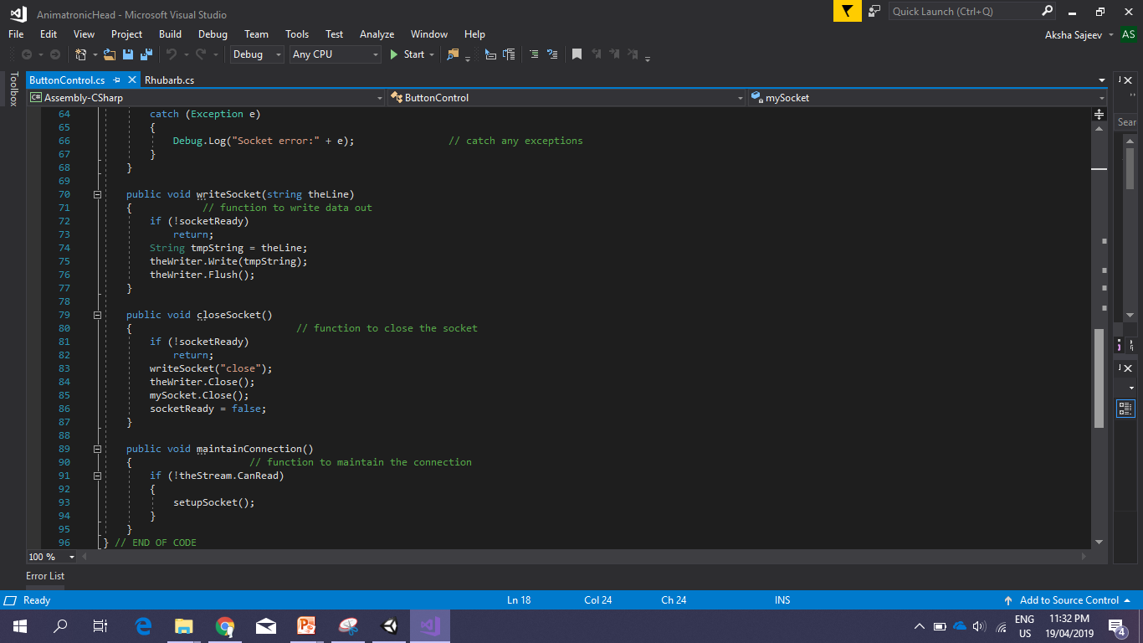

Slide 23
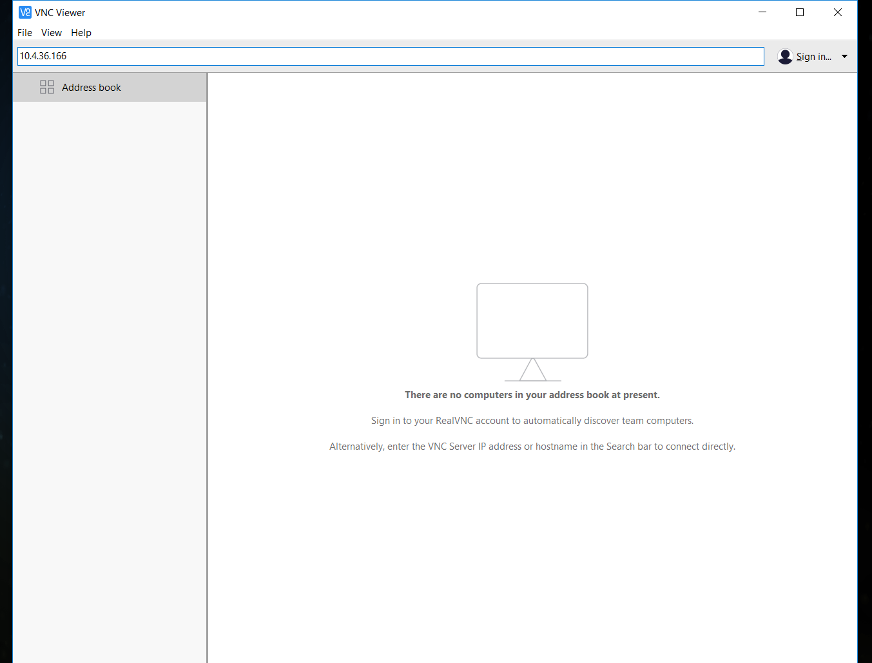
Running
Notes:
Tulle foating necklace
Blogs, open source models:sell their models or share it to print, tutorials and classes and straight out buy them.
Alternative work with companies that provide 3d printing services , Work with a skilled product designer to turn your ideas into real products.
https://www.shapeways.com/
https://www.sculpteo.com/en/
https://www.aniwaa.com

Slide 24
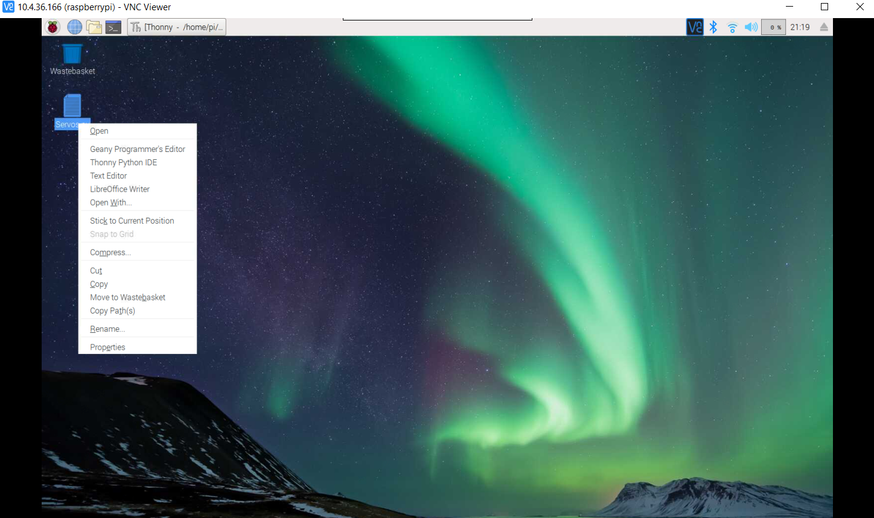
Running
Notes:
Tulle foating necklace
Blogs, open source models:sell their models or share it to print, tutorials and classes and straight out buy them.
Alternative work with companies that provide 3d printing services , Work with a skilled product designer to turn your ideas into real products.
https://www.shapeways.com/
https://www.sculpteo.com/en/
https://www.aniwaa.com

Slide 25
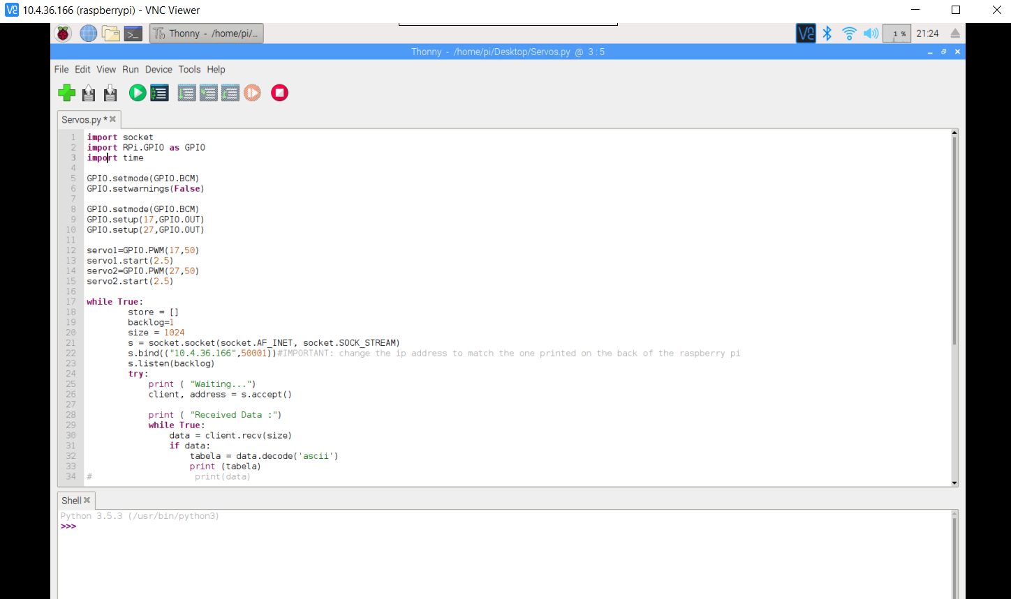
Running
Notes:
Tulle foating necklace
Blogs, open source models:sell their models or share it to print, tutorials and classes and straight out buy them.
Alternative work with companies that provide 3d printing services , Work with a skilled product designer to turn your ideas into real products.
https://www.shapeways.com/
https://www.sculpteo.com/en/
https://www.aniwaa.com

Slide 26
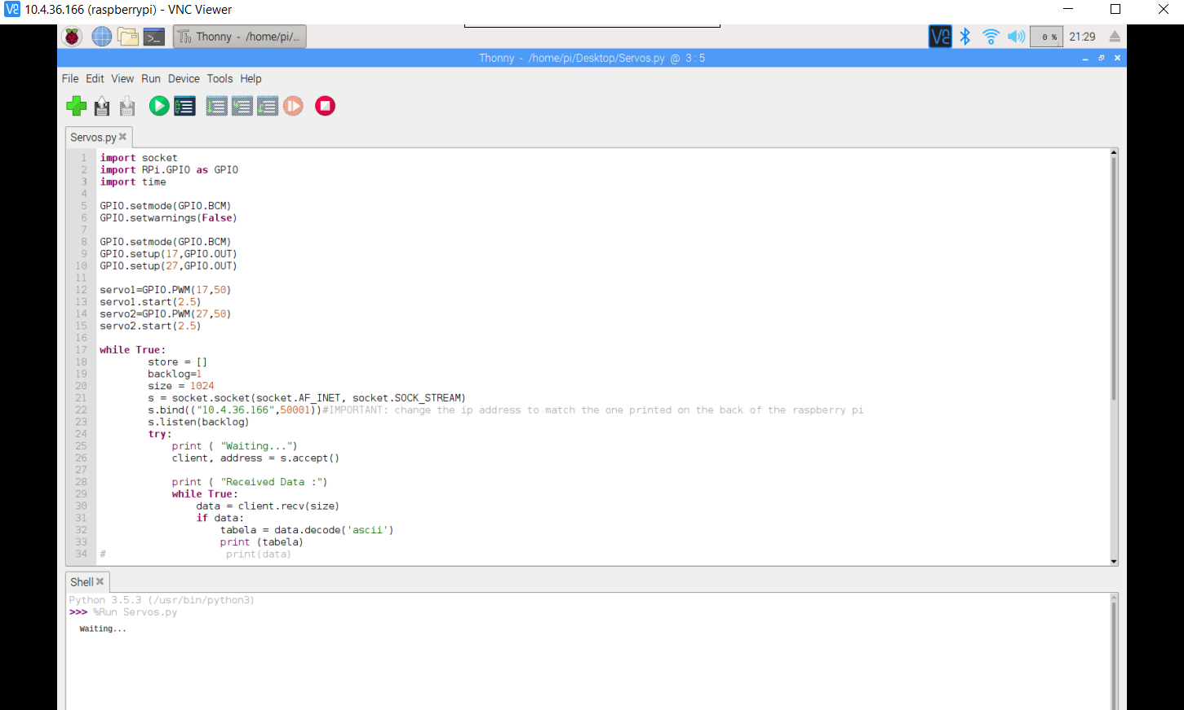
Running
Notes:
Tulle foating necklace
Blogs, open source models:sell their models or share it to print, tutorials and classes and straight out buy them.
Alternative work with companies that provide 3d printing services , Work with a skilled product designer to turn your ideas into real products.
https://www.shapeways.com/
https://www.sculpteo.com/en/
https://www.aniwaa.com

Slide 28
THANK YOU!

